Slide 1
Introduction to Visual C#.Net

Slide 2
Objectives
1-Introduction To Programming
2-History
3-Why Programming
4-Introduction to C#.NET
5-Features of .NET
6-machine language, assemble language and high-level language
7-Application of C#
8-Installation (IDE)

Slide 3
What is programming
Programming is the act of giving set of instructions to the computer to perform specific task.
peoples do programming to solve the problems they face and to automate their manual work.
their is a big difference between Software and Program. Software is a collection of programs for multiple task while program is a set of instructions that perform specific task.

Slide 4
Cont..
Software can be divided into two categories:
A- System Software: this is a software which is able to communicate with the Hardware like OS, Device Drivers. The person is called System Programmer
B- Application Software: is a software which can not communicate with the Hardware like Notepad, Excel. The person is called Application Programmer

Slide 5
WHAT IS PROGRAM?
An application or a program as it also is called can refer to many different things. It can be a desktop application which runs on Windows or Mac OSX like the calculator, a word processor or a spread sheet, but it can also be a web site or even something smaller like the application built in to a kitchen appliance.
In its simplest form a program is comprised of algorithms that will process data which either is fetched from a data store, such as a database, a file or user input.
Fetched data whether from a data store or user input can then be run through one or more algorithms to reach the goal set up for that algorithm sequence, such as display order data to a customer, calculate the total price for the items in an online shopping cart, or save data back to the data store.

Slide 6

what is an algorithm
An algorithm is code that describes how data will be entered/fetched from a data store, a keyboard or other types of input devices and subsequently manipulated, calculated, displayed and/or saved back to a data store.
When implementing code using a modern programming language algorithms are often placed in what is known as methods or functions for easier reuse. Though there arguably can be differences between methods and functions in some languages the names will be used interchangeably in this book.

Slide 7
The language of a computer
The core (brain) of a computer is its processor (CPU) which does all the calculations and runs all the algorithms. As of the writing of this book it is very common with multi-core processors meaning that they can execute multiple requests at the same time making the computer work faster. A 4-core processor can run 4 algorithms in parallel.
The processor work with low-level instructions which is specific to certain types of processors. This mean that a program you write for a PC might not work on another personal computer. The low-level instructions are interpreted differently depending on what operating system the application was created for, this means that a program compiled (built) for the Windows operating system cannot be executed on for instance Mac OSX. On more modern Mac computers you can run what is called dual boot where you actually can install Windows on the computer enabling you to run the PC application provided the Mac is booted with Windows

Slide 8
Cont…
All instructions sent to the processor is in binary format 0's and 1's. This means that your C# code must be converted into binary machine code somehow. For .NET applications this is a two stage rocket where the C# code first is compiled by Visual Studio into what is known as IL/MSIL (Intermediate language). The IL code can be viewed as C# code which has been turned into intermediate instructions which the .NET framework Just-in-time (JIT) compiler then can turn into low-level machine code (0's and 1's) when the application is run. The JIT compiler is even smart enough to only compile the code that is needed for the task at hand and to cache methods that already have been executed speeding up the execution for subsequent calls.

Slide 9
why programming
Peoples perform tasks on daily basis which might take long time and is difficult to complete.
Computer came up with two important factors;
1. Accuracy and
2. Speed.
we do programming to automate our tasks, speed up our business and .

Slide 10
machine languages, assembly languages and high-level languages
programmers write instructions in various programming languages (such as C#), some directly understandable by computers and others requiring intermediate translation steps.
Machine Languages
Any computer can directly understand only its own machine language, defined by its hardware architecture. Machine languages generally consist of numbers, ultimately reduced to 1s and 0s. Such languages are cumbersome for humans, who prefer words like “add” and “subtract” to indicate the operations to be performed, so the machine language numeric versions of these instructions were referred to as code. The term “code” has become more broadly used and now refers to the program instructions in all levels of language.

Slide 11
Cont..
Assembly Languages and Assemblers
Machine language was simply too slow and tedious to work with. Instead, programmers began using English-like abbreviations to represent elementary operations. These abbreviations form the basis of assembly languages. Translator programs called assemblers convert assembly-language code to machine code quickly. Although assembly-language code is clearer to humans, it’s incomprehensible to computers until translated to machine language code.

Slide 12
Cont..
High-Level Languages, Compilers and Interpreters.
To speed the programming process even further, high-level languages were developed in which single statements could be written to accomplish substantial tasks. High-level languages, such as C#, Visual Basic, C++, C, Objective-C and Java, allow you to write instructions that look almost like everyday English and contain commonly used mathematical expressions. Translator programs called compilers convert high-level language code into machine language code.
The process of compiling a large high-level language program into machine language can take a considerable amount of computer time. Interpreter programs were developed to execute high-level language programs directly (without the need for compilation), although more slowly than compiled programs.

Slide 13
What is c#
C# is a modern, general-purpose, object-oriented programming language developed by Microsoft and approved by European Computer Manufacturers Association (ECMA) and International Standards Organization (ISO).
C# was developed by Anders Hejlsberg and his team during the development of .Net Framework.
C# is programming language developed Microsoft in 2002
C# is designed for Common Language Infrastructure (CLI), which consists of the executable code and runtime environment that allows use of various high-level languages on different computer platforms and architectures.

Slide 14
Cont..
C#, pronounced as C Sharp, is an object-oriented programming language developed by Microsoft in the early 2002s, led by Anders Hejlsberg. It is part of the .Net framework and is intended to be a simple general-purpose programming language that can be used to develop different types of applications, including console, windows, web and mobile applications. Like all modern programming languages,
C# code resembles the English language which computers are unable to understand. Therefore, C# code has to be converted into machine language using what is known as a compiler (refer to footnote). The compiler that we’ll be using in this book is the free Visual Studio Community 2015 provided by Microsoft.

Slide 15
Why Learn C#?
C# has syntax and features that resemble other programming languages like Java and C++. As such, if you have any prior programming experience, you will find learning C# a breeze. Even if you are totally new to programming, C# is designed to be easy to learn (unlike C or C++) and is a great first language to learn.
In addition, C# is part of the .Net framework. This framework includes a large library of pre-written code that programmers can use without having to write everything from scratch. This allows programmers to rapidly develop their applications in C#, making C# the ideal language to work with if you are on a tight schedule.
Lastly, C# is an object-oriented programming (OOP) language. Object-oriented programming is an approach to programming that breaks a programming problem into objects that interact with each other. We’ll be looking at various object-oriented programming concepts in this book.

Slide 16
the following reasons make c# a widely used professional language
It is a modern, general-purpose programming language
It is object oriented.
It is component oriented.
It is easy to learn.
It is a structured language.
It produces efficient programs.
It can be compiled on a variety of computer platforms.
It is a part of .Net Framework.

Slide 17
strong programming features of c#
Following is the list of few important features of C# −
Boolean Conditions
Automatic Garbage Collection
Standard Library
Assembly Versioning
Properties and Events
Delegates and Events Management
Easy-to-use Generics
Conditional Compilation
Simple Multithreading
Integration with Windows

Slide 18
Application of C#.NET
The .Net framework is a revolutionary platform that helps you to write the following types of applications −
1-Desktop Apps
2-Web Apps
3-Mobile Apps
4-Distributed Technologies (Webservices)

Slide 19
Getting ready for C#
Installing Visual Studio Community
Before we can start developing applications in C#, we need to download Visual Studio Community. As mentioned in Chapter 1, Visual Studio Community (VSC) is a free complier provided by Microsoft.
In fact, VSC is more than just a compiler. It is an Integrated Development Environment (IDE) that includes a text editor for us to write our code and a debugger to help us identify programming errors.

Slide 20
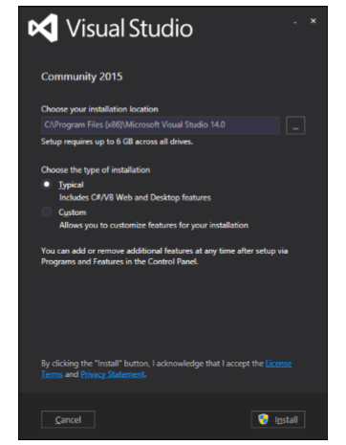
Installation
Microsoft provides a free version of visual studio which also contains SQL Server and it can be downloaded from www.visualstudio.com.
Step 1 − Once downloading is complete, run the installer. The following dialog will be displayed.

Slide 21
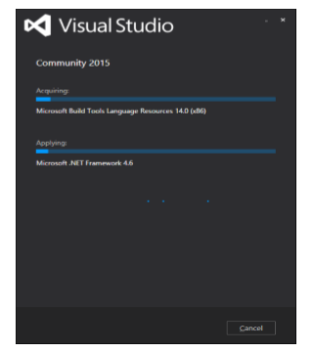
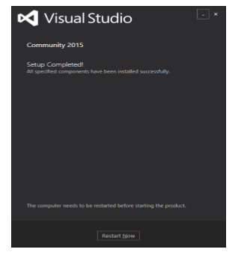
Cont..
Step 2 − Click on the Install button and it will start the installation process.
Step 3 − Once the installation process is completed successfully, you will see the following dialog. Close this dialog and restart your computer if require

Slide 22
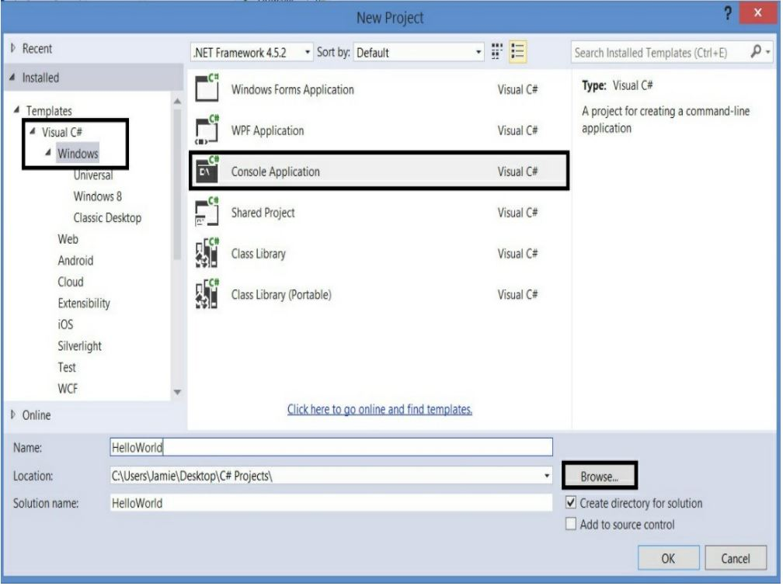
Your First C# Program

Slide 23
